Slide 1

The NKS Healthy Community Blog
NKS is a school for people like me
The purpose of this monthly blog is to promote a healthy culture and ethos across the school - a culture that challenges inequality and promotes positive ideals of how we should respect and treat each other.
Volume 2– Dec ‘25

Slide 2
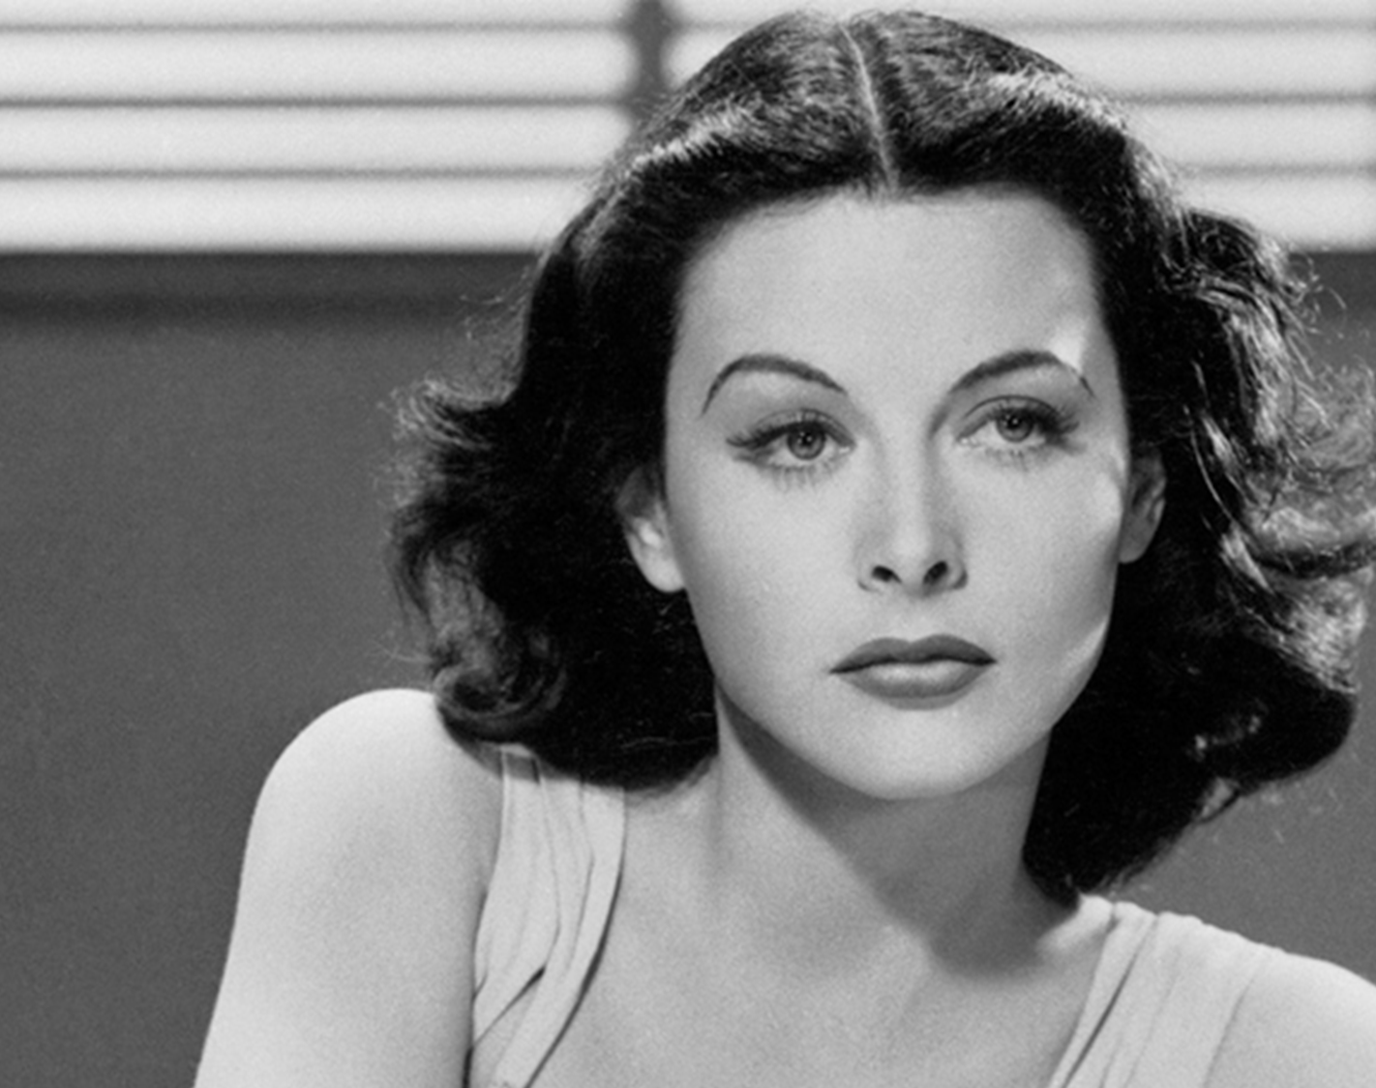
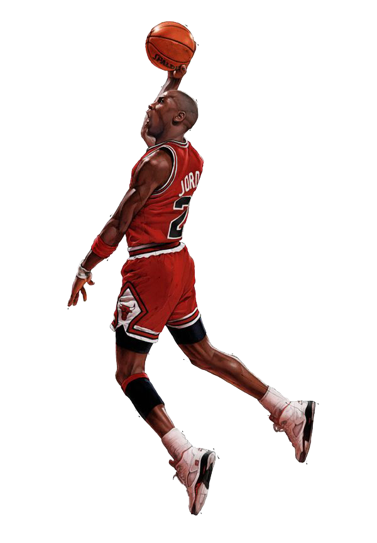
INSPIRATIONAL PEOPLE

Slide 3

Hedy Lamarr was once known as ‘the most beautiful woman in the world.’ An icon of the silver screen, she appeared in thirty films alongside other Hollywood greats. Her most resounding legacy, however, wasn’t in cinema at all. Instead, it can be found in the patent she filed in 1941 for a frequency-hopping communication system. The technology she created with famed composer George Antheil was designed to make radio-guided torpedoes harder to detect or jam. Her innovation formed the basis for the wireless technologies we use every day. It was the precursor to numerous widespread technologies like Bluetooth, GPS, and secure Wi-Fi. And she achieved it while making some of the century’s most iconic movies – impressive, right?
Hedy Lamarr

Slide 4
Michael Jordan
Michael Jordan is arguably the greatest pro basketball player of all time.
He finished with six NBA titles and one of the best careers in league history.
What's even more inspiring about his accomplishments was that he was able to do all this despite getting cut from his high school team, losing his father and failing at his other dream of playing pro baseball.
"I've failed over and over and over again in my life.
And that is why I succeed.” – Michael Jordan

Slide 5
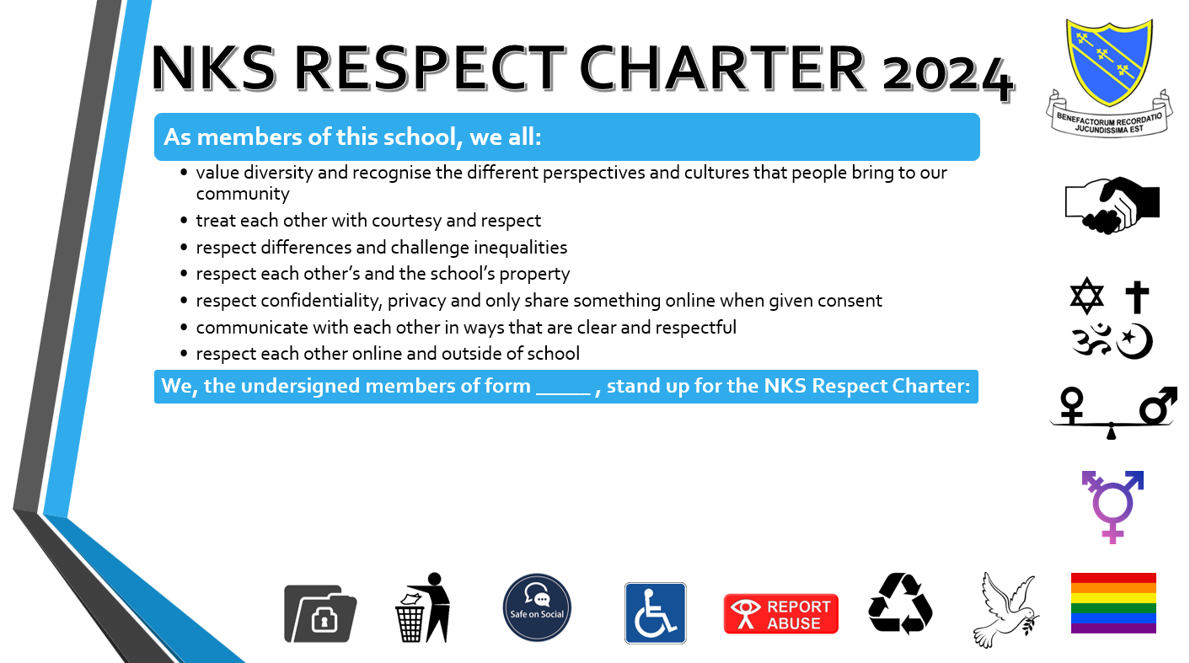

It’s time to renew the NKS RESPECT CHARTER…
The charter was created by the School Council a few years ago. The current School Council will be reviewing it in their December meeting. It is our public way of expressing how we expect to be treated and therefore how we should treat others. Once the new charter is agreed, each form will have a copy, and everyone has the opportunity to sign up to it.

Slide 6

Who Are White Ribbon UK?
1. Mission and Goals
  White Ribbon UK focuses on preventing men's violence against women by addressing root causes like harmful gender norms and toxic masculinity.
2. Engaging Men and Boys
  The charity works with men and boys to become allies and advocates through programmes promoting respectful relationships and challenging harmful behaviours.
3. Collaborations and Outreach
  White Ribbon UK partners with over 500 organisations including workplaces and schools to foster cultural change towards ending gender-based violence.
4. Symbolism and Intersectionality
  The white ribbon symbolizes commitment to ending violence, while the approach recognizes diverse experiences based on identity and promotes accountability.
A leading charity in England and Wales engaging men and boys to prevent men’s violence against women and girls.
This month’s non-uniform day on 19th December is raising money for White Ribbon UK

Slide 7
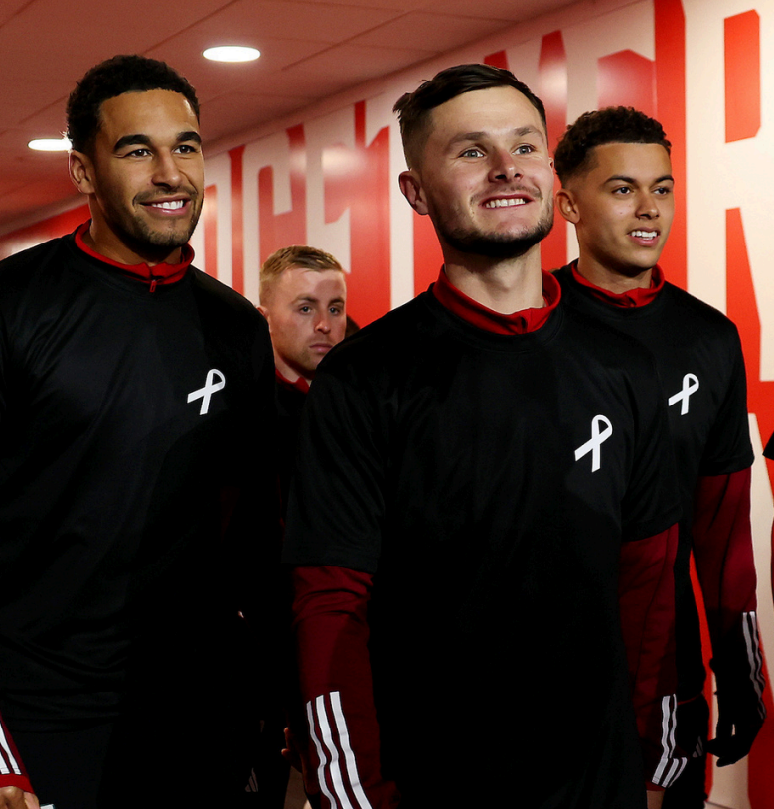
Why NKS Supports White Ribbon UK?
Educational Programmes on Respect
  The aims of the charity closely align with our school curriculum on teaching healthy relationships, gender equality, and respect.
Promoting Positive Masculinity
  It helps us challenge harmful stereotypes, helping young men unlearn toxic norms and become changemakers in their communities.
Empowering Boys Against Abuse
  Helps raises awareness among young men about sexism and abuse, empowering them to support peers and stand against violence.
Building Inclusive School Environment
  The charity provides us with solid foundation to engaging boys in gender equality discussions, thereby fostering a safer, respectful, and more inclusive school culture.

Slide 8
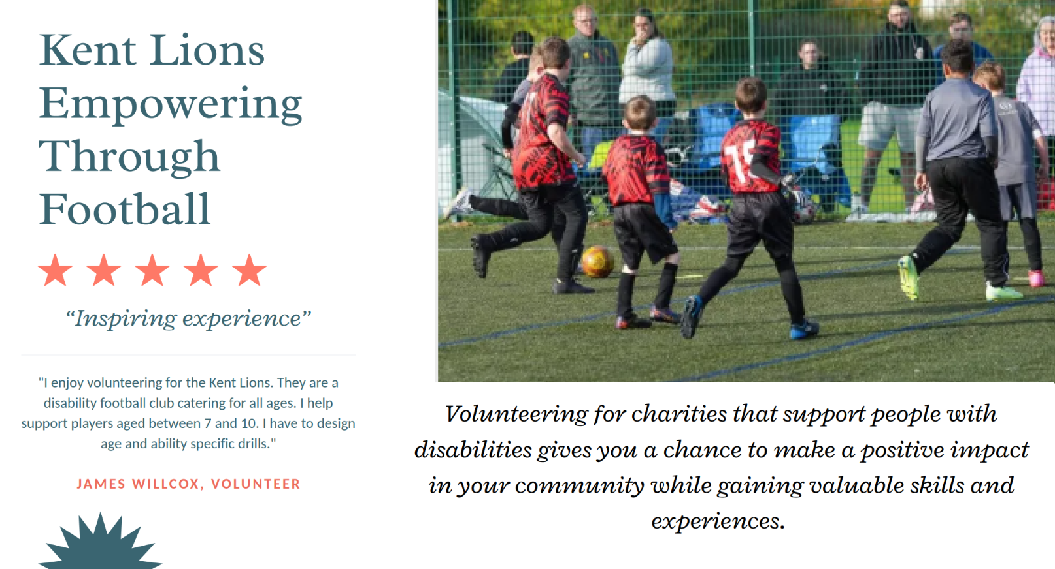

Slide 9
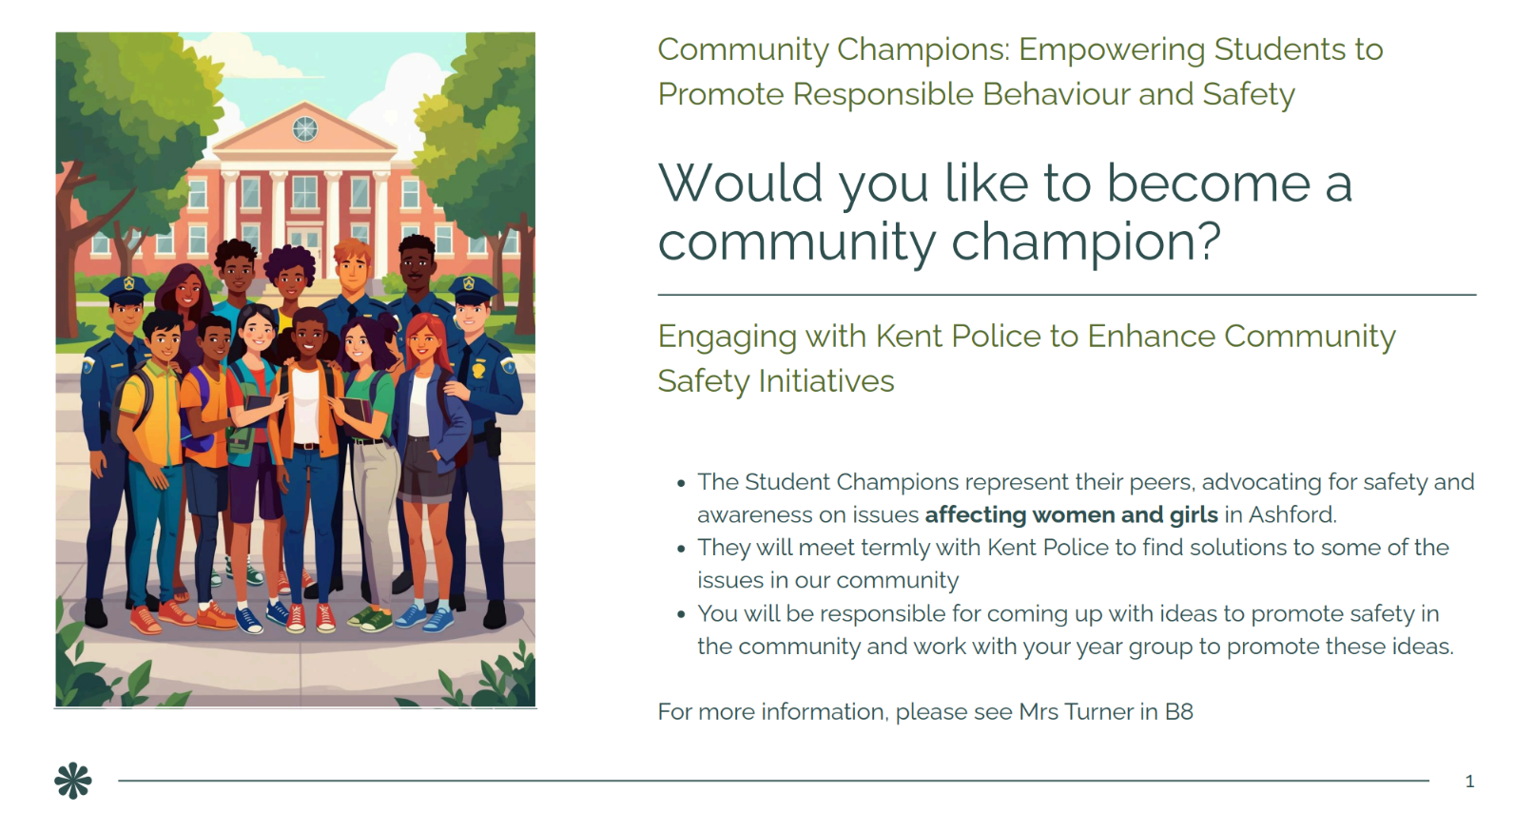

Slide 10
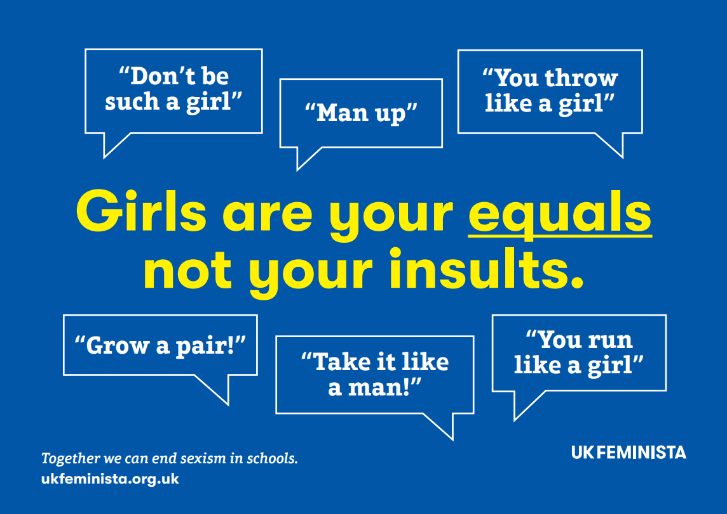

Slide 11
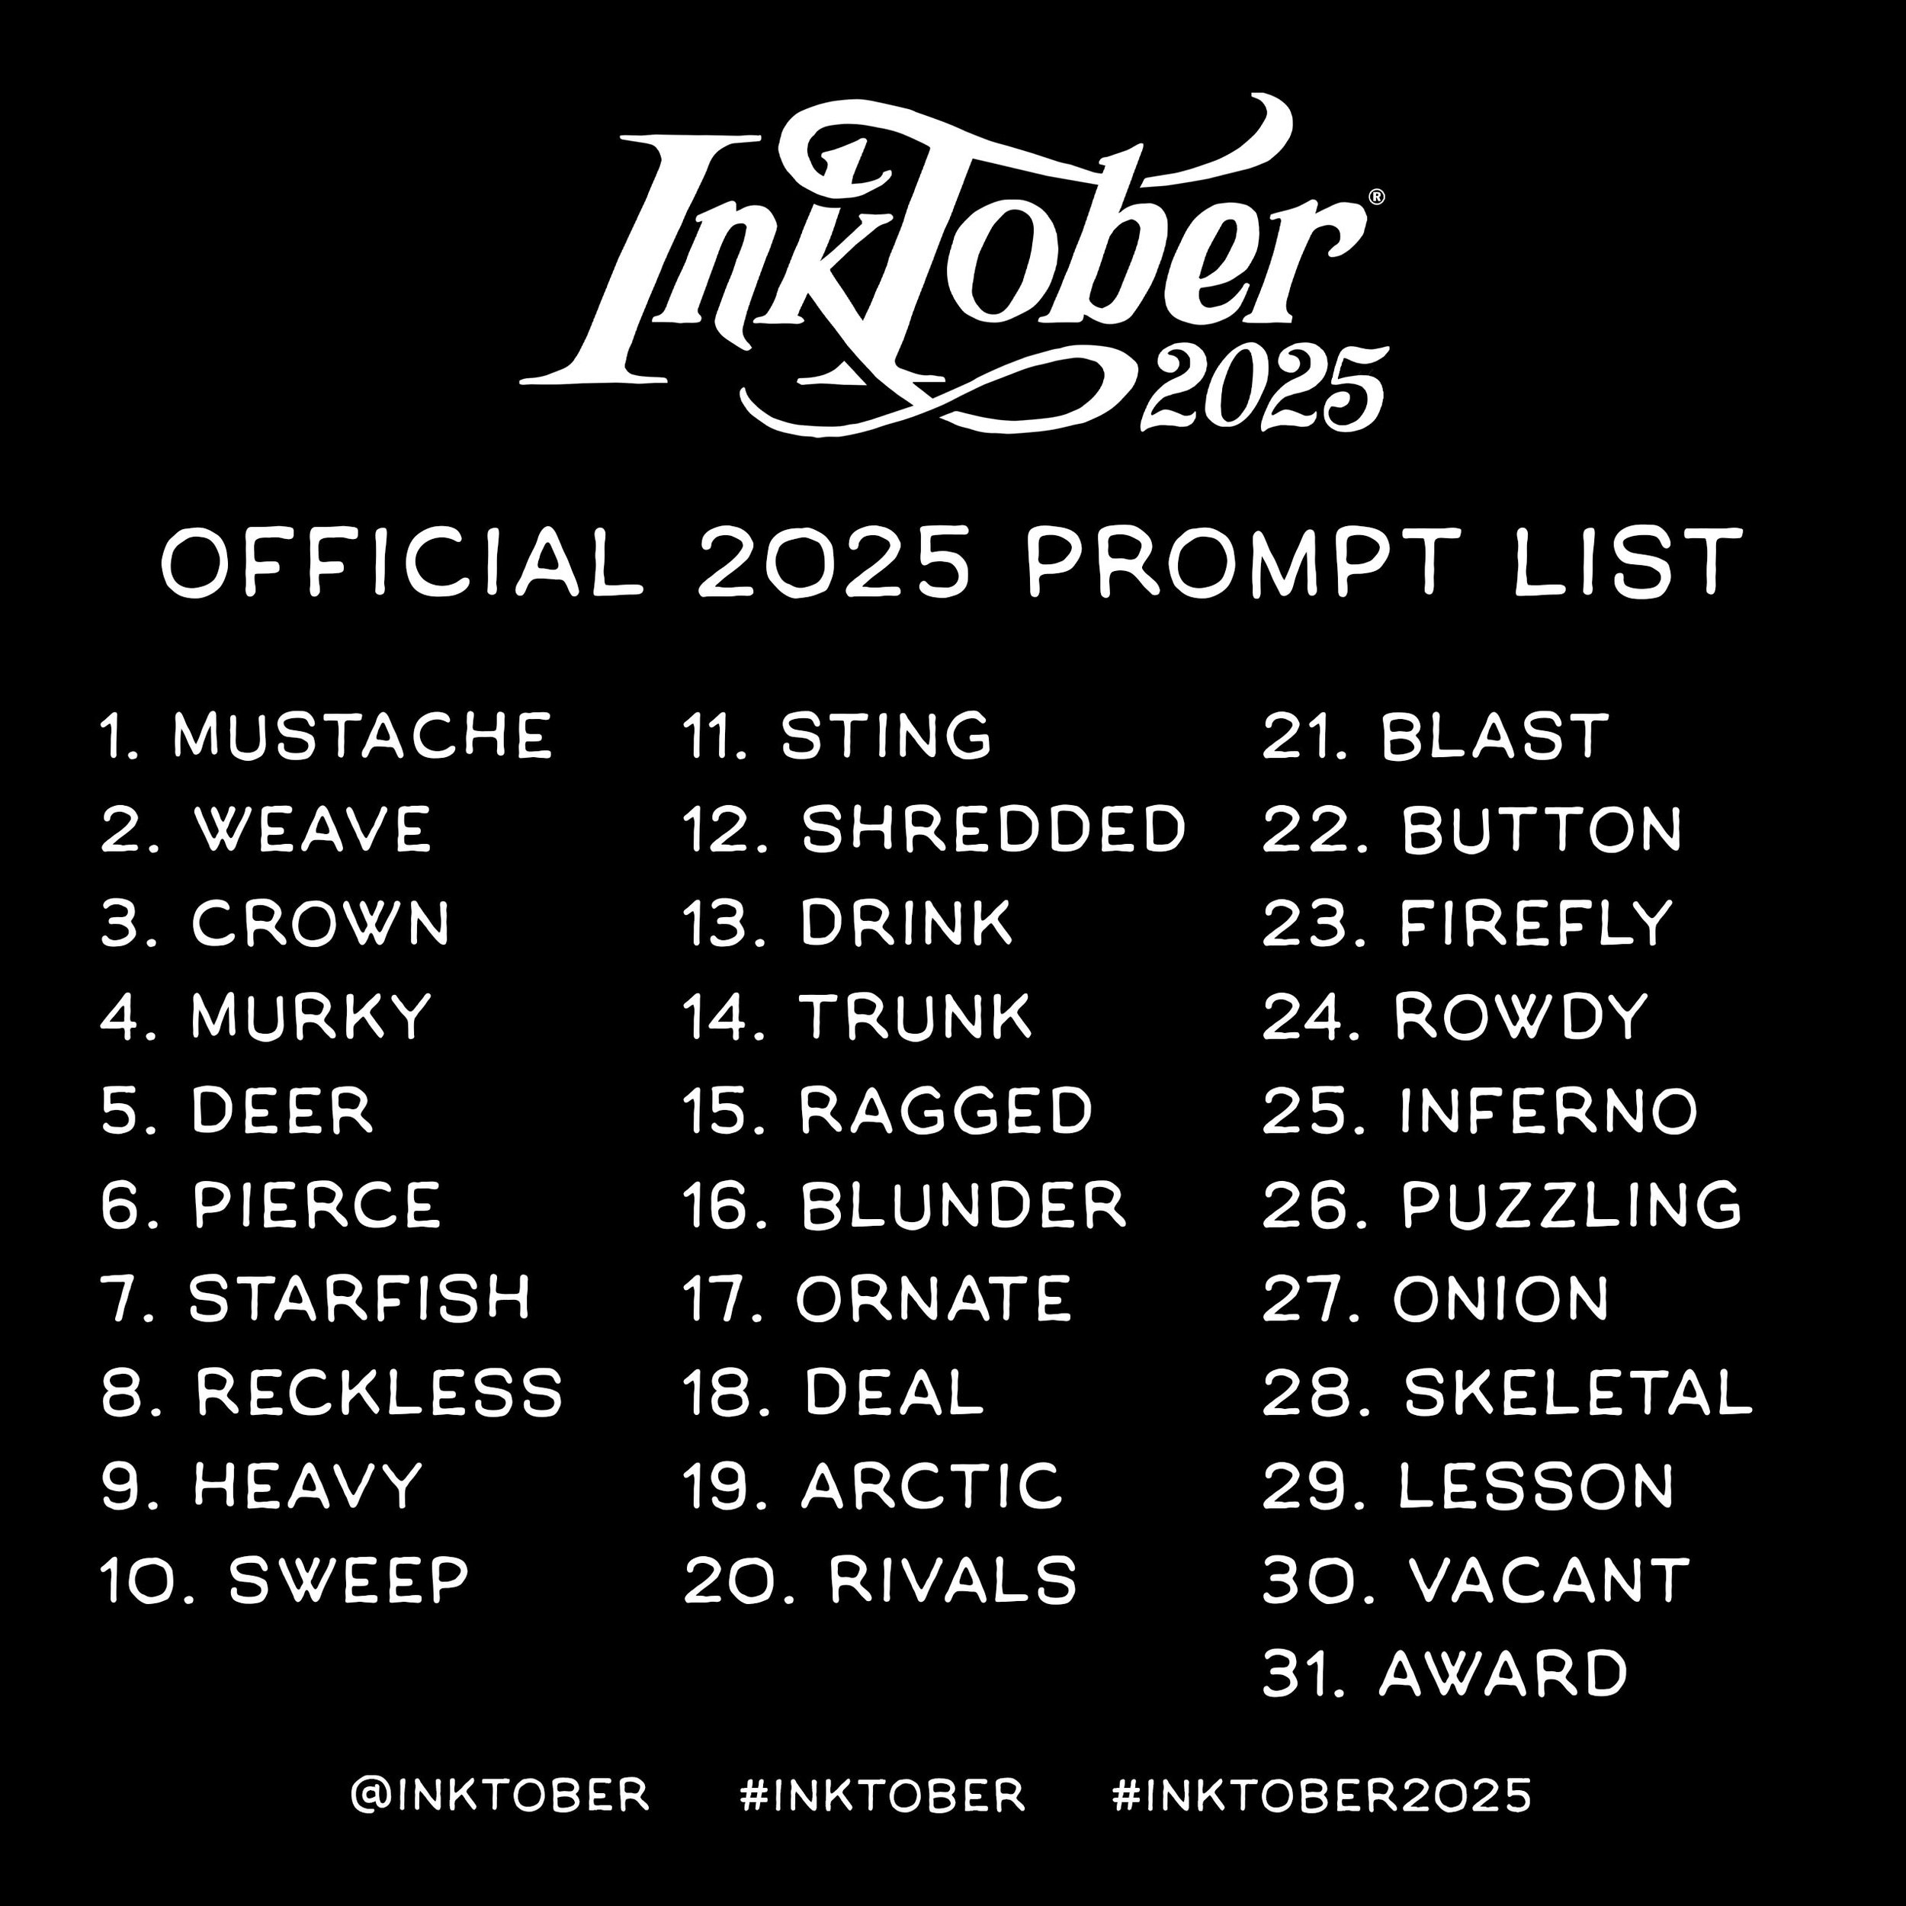
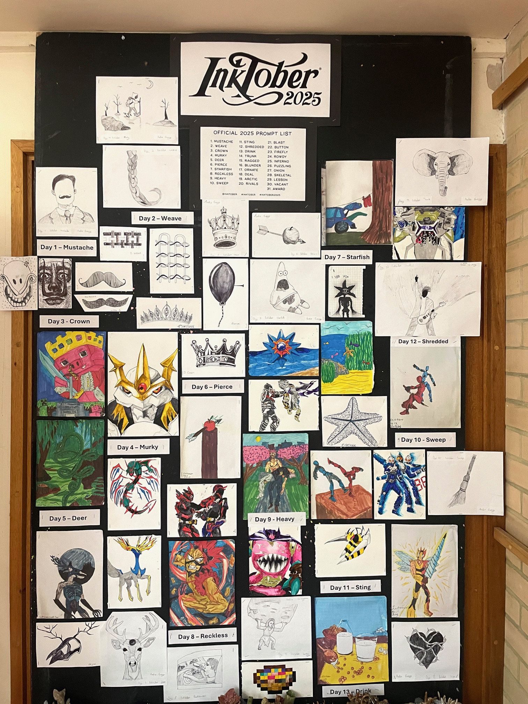
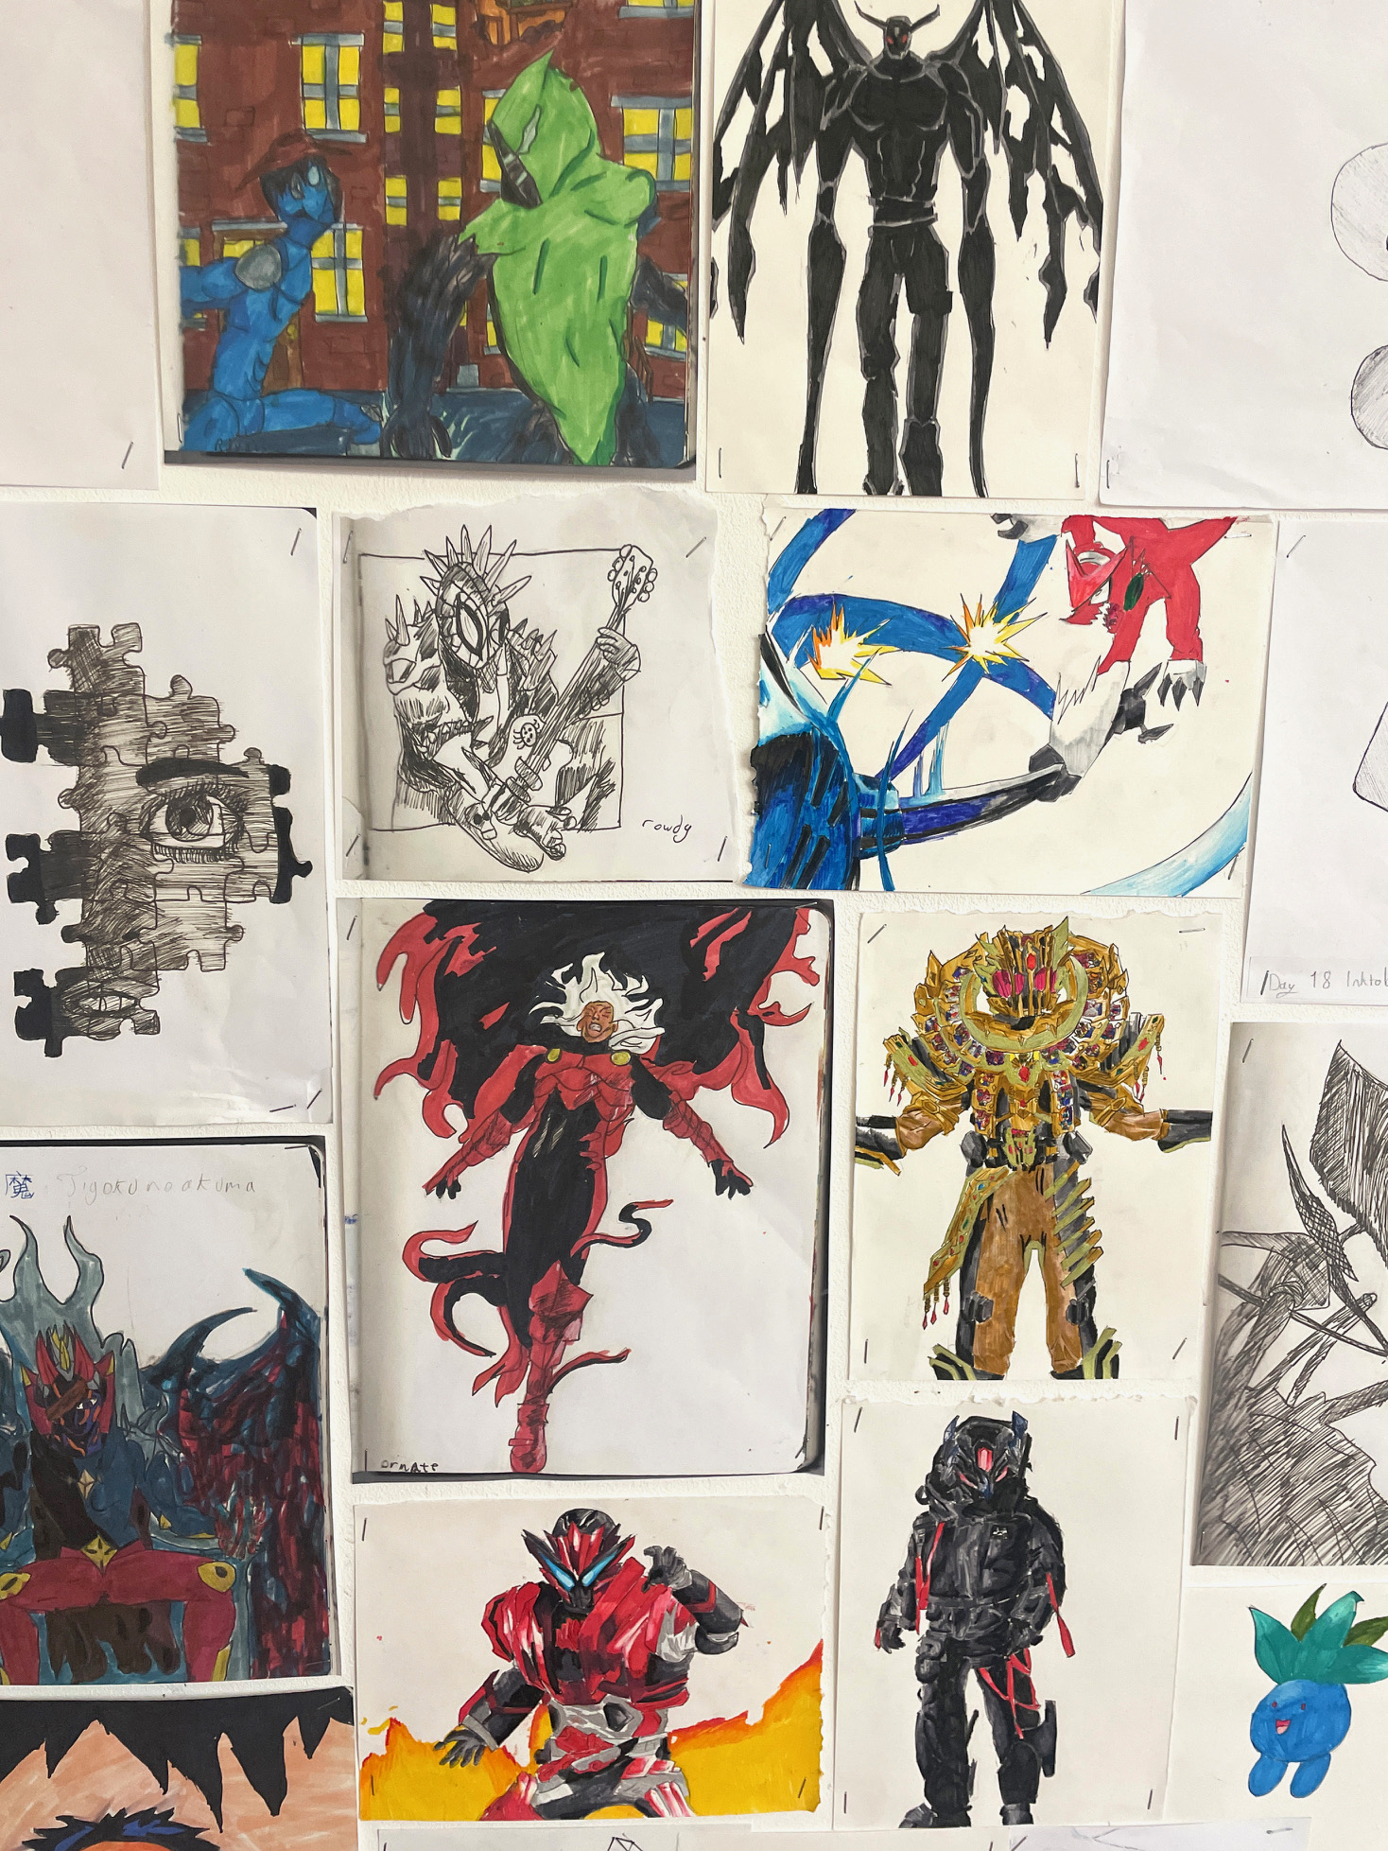

This year, the Inktober challenge proved to be more popular than ever, with participation from both students and staff. The Hinks Gallery has been showcasing the efforts of all Inktober artists. We look forward to next year's Inktober prompt list, hoping it will inspire even more creativity among our NKS community!
Inktober was created in 2009 as a challenge to develop and improve positive drawing habits
"Inktober's fun and helps you to get better at drawing. You get a new prompt every day, so you're never stuck. It's chill, good for stress, and something to do with friends. Even if you're not into art, you can still try"
Jacob, Year 9
"I started doing the Inktober drawings because I got interested in certain topics. This Inktober event helped me develop and improve my skills...and also made me relax"
Hoi, Year 9
"Art is not usually an activity I would do to unwind in the evenings. Unwinding is not easy for me to do!
Inktober has been a real game changer for my well-being and have found a creative side which I will continue to explore when Inktober ends"
(Mrs Wilkinson-Snare –AEN)

Slide 12


HOW TO KEEP MOTIVATED DURING THE WINTER MONTHS
Go out for a walk in daylight instead of staying in your room all day
Don’t shut yourself away, talk to friends and family on a daily basis
Start a new hobby, learn to play a musical instrument
Have positive thoughts, do not dwell on the negative
Challenge yourself or friends in games, e.g. arrange a football match
Make arrangements in advance to meet up with friends, giving you something to look forward to
Do a kind deed each day
Look out for others that might be in a low mood or behaving differently and help lift their mood
Make sure you have at least 8hrs of continuous sleep each night
Drink plenty of water and have a healthy diet. Not too many sugary foods
Do one thing each day that you enjoy doing

