Slide 1

The NKS Healthy Community Blog
NKS is a school for people like me
The purpose of this monthly blog is to promote a healthy culture and ethos across the school - a culture that challenges inequality and promotes positive ideals of how we should respect and treat each other.
Volume 4 – March ‘26

Slide 2

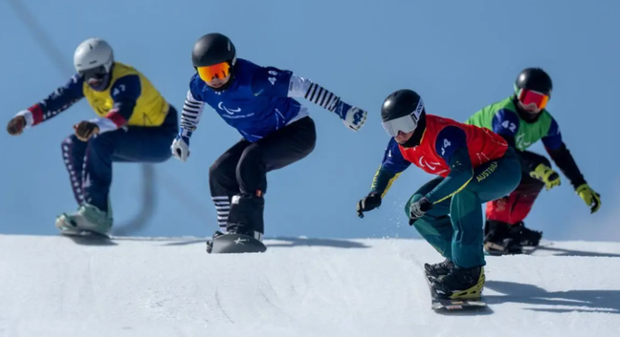
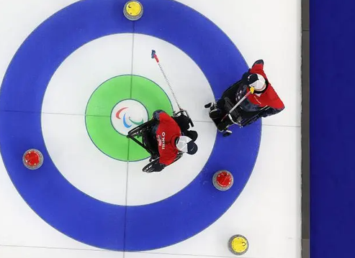

Milano Cortina Paralympics
Milano Cortina Paralympics
6th - 15th of March
The Milano Cortina Paralympic games mark 50 years since the first Winter Paralympics. It is the second time they have been held in Italy.
This year, wheelchair curling mixed doubles will feature for the first time.
Around 665 athletes will compete in 79 medal events across 6 sports.
These sports are:
Para Alpine Skiing
Para Biathlon
Para Cross Country Skiing
Para Ice Hockey
Para Snowboard
Wheelchair Curling

Slide 3
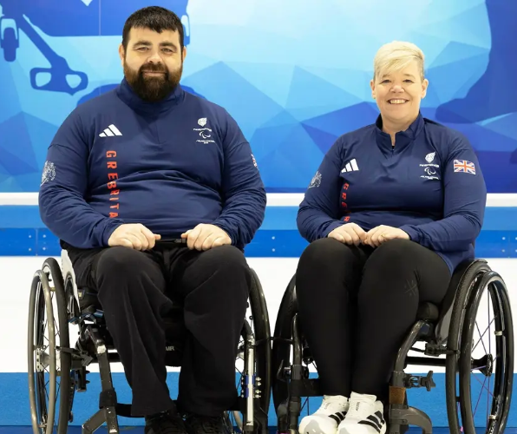
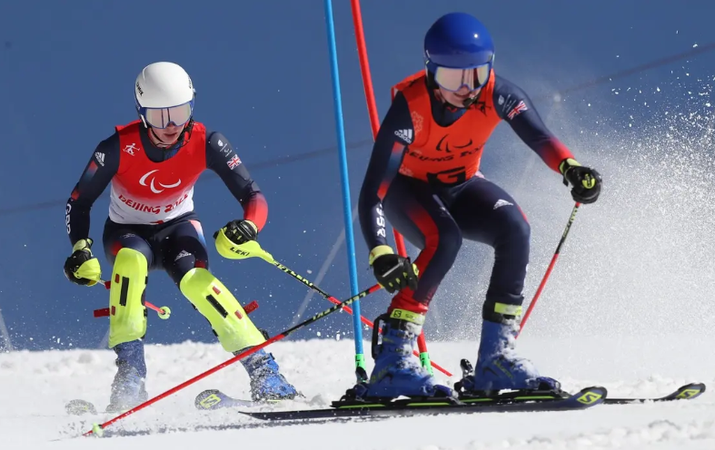
Athletes to watch
Neil Simpson (with Andrew Simpson and Rob Poth)
Jo Butterfield MBE & Jason Kean
Mixed Doubles Curling
Para Alpine Skiing
They are the first Brits to compete in the Mixed Doubles event. Jo is chasing a rare Summer/Winter double gold, as she won Gold in Rio 2016 in Para athletics.
Neil is the defending champion of the Beijing 2022 Gold medal. He is visually impaired, and will be guided by his brother, Rob Simpson, in speed events and Rob Poth in technical events.

Slide 4
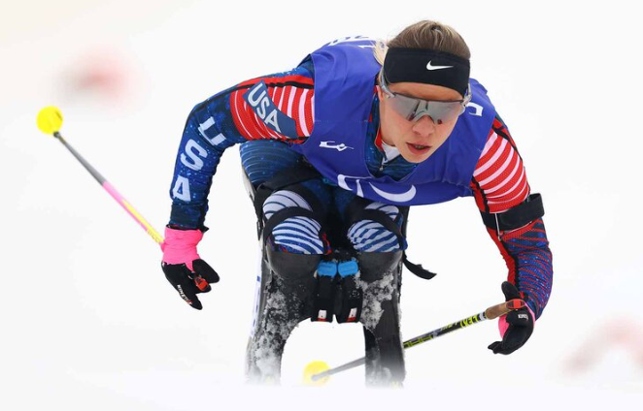
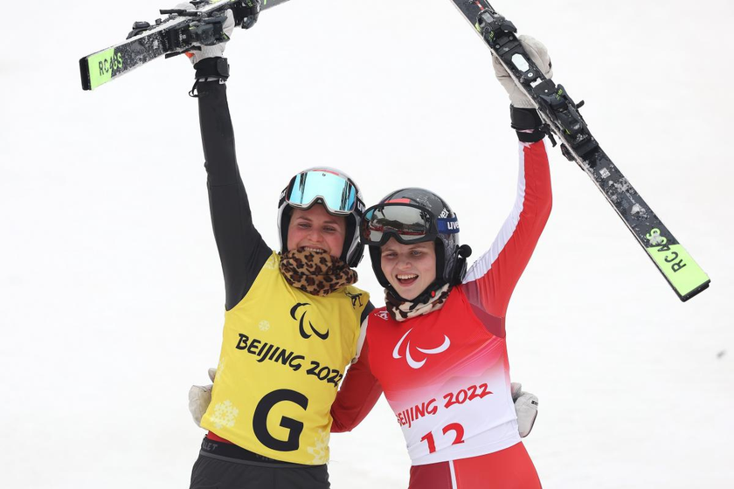
Athletes to watch
Oksana Masters
The Aigner Siblings
Para Biathlon
Para Alpine Skiing
Oksana Masters is the USA’s most decorated Paralympian of all time. She has 19 medals across 4 sports: Para cross-country skiing, Para biathlon, Para cycling and Para rowing.
Veronika and twins Johannes and Barbara won nine out of the 11 medals that Austria earned in Para Alpine Skiing at Beijing 2022, racing in the vision impaired class. This year, they are aiming for 10 medals.

Slide 5
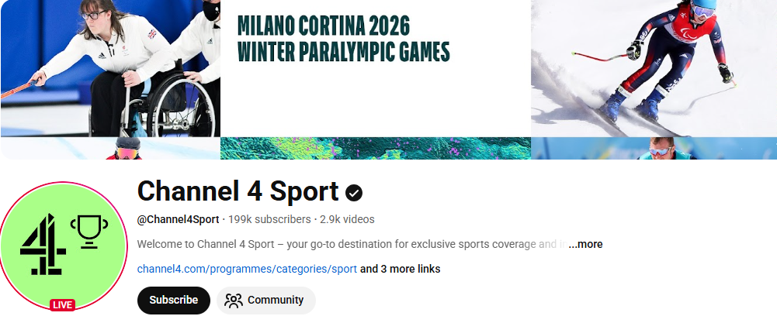

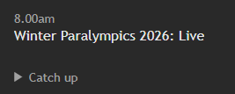
Where to watch?
The Channel 4 Sport YouTube channel is streaming 60 hours of sports across the games.
It is also on Channel 4 from 8am - 2pm every day.
Highlights of the whole Paralympic day are shown on Channel 4 at 6:30pm - 7pm every day, making it really easy to catch up on anything you might have missed!

Slide 6
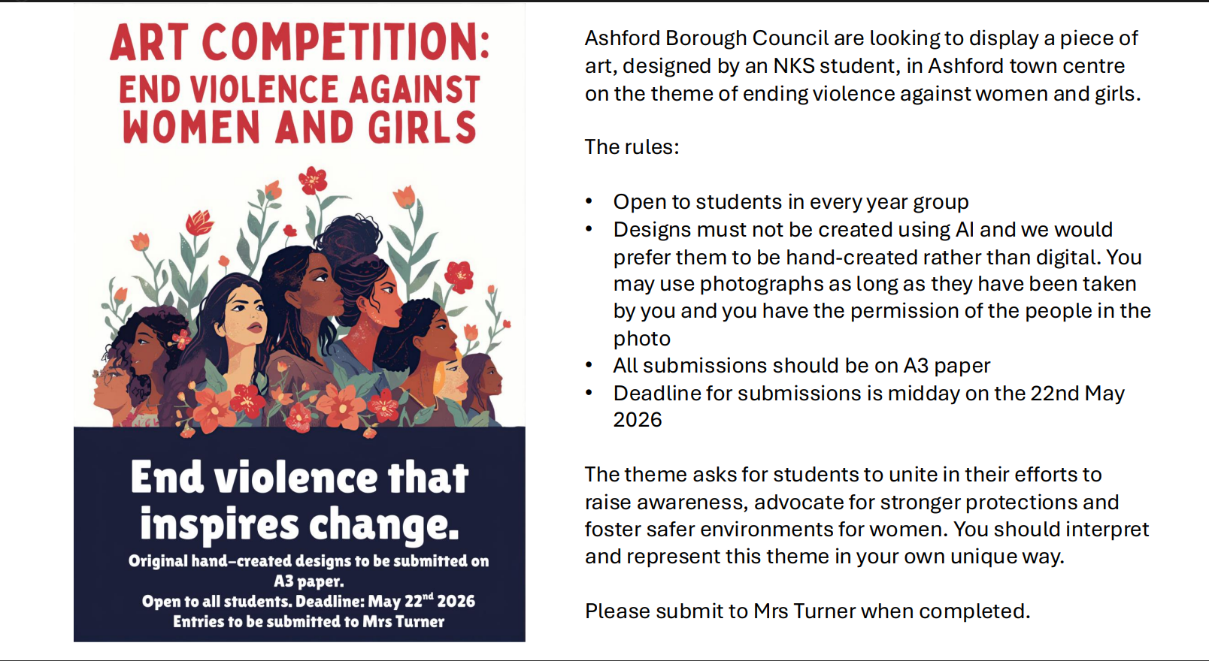

Slide 7
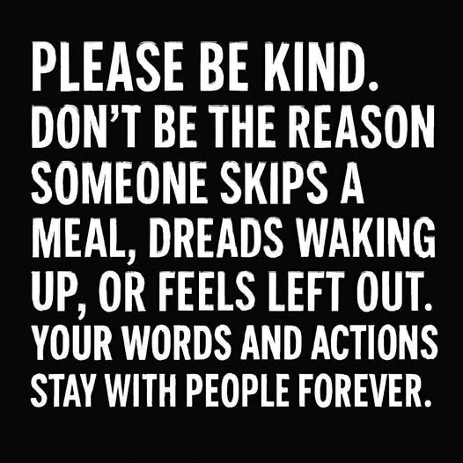
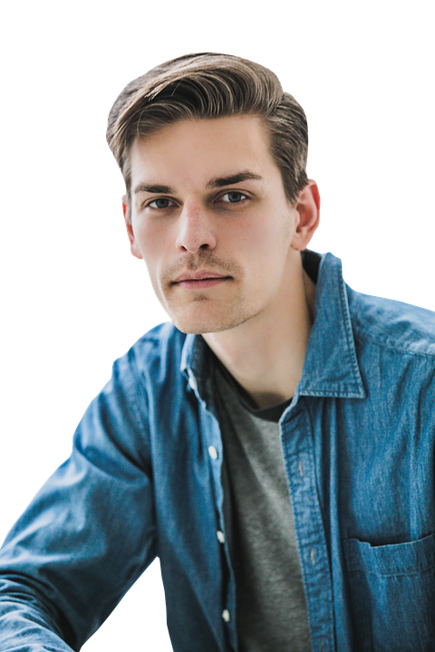
NKS Healthy Community Blog
I must be careful and not use unkind words
Think Before You Speak!
Your Unkind Words & Actions Will Stay With Someone Forever
Source: Mental Health Believe UK

Slide 8
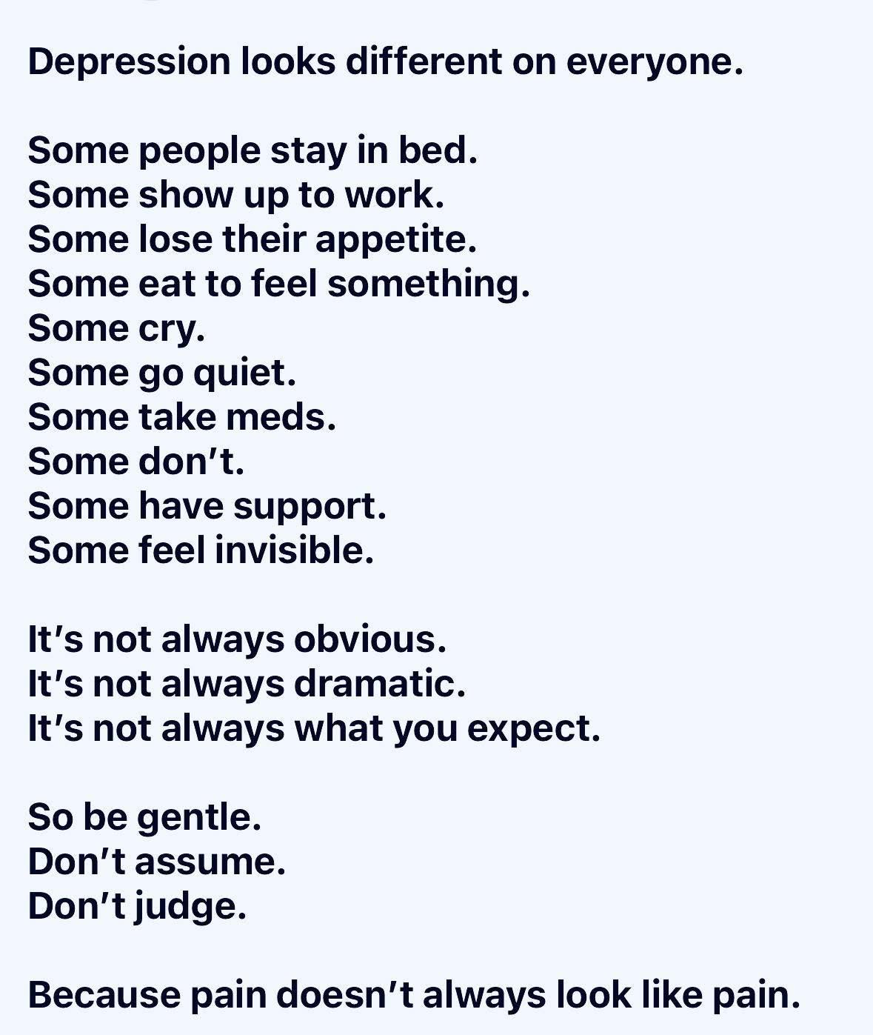

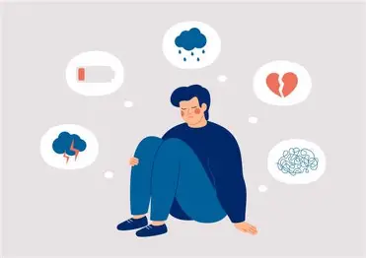

NKS Healthy Community Blog
If you, or one of your friends, is feeling low – talk to your SSM.
They are there to help!
Source: Mental Health Believe UK

Slide 9


Reminder…
There are many terms that NKS has agreed it is totally unacceptable to use. The following examples relate to racism…

Slide 10
The ‘N’ - word
The use of the ‘N’ - word is a hate crime. It is one of the most horrible words in the English language and must not be used. The ‘N’- word has been used aggressively throughout history, often accompanied by physical violence. It is a derogatory and dehumanising racial slur directed at black people. Because of its deeply offensive and problematic previous usage; no matter the circumstance, it is unacceptable.
ADDITIONAL DETAIL The use of the term derives originally from the Atlantic slave trade in the 16th century. The Africans slaves were referred to using the Spanish and Portuguese words for black – negro. The ‘N’ word has derived from that. From this early time, the ‘N’ word was tied into the idea that African people weren't really viewed as human beings; but seen more like animals or beasts of burden, that could be bought and sold. Millions of black people were taken from their homes in Africa, chained up in horrendous conditions on slave ships and taken across the Atlantic to be sold as slaves. At that time in history, these people literally had no rights. Following on from this, white slave owners would use the n-word to demean and further oppress Black people. The ‘N’ word in literature – note for English lessons Some books covered at school include the ‘N’ – word in the text. One example is 'Of Mice and Men'. It was a word used at the time the novel was written, and the author uses it to highlight a point about discrimination and racism which was prominent in America at the time. When studying any book that includes the ‘N’ - word we wouldn't read it out and it should not be used when discussing the book.

Slide 11
Slavery reference
Making slurs relating to slavery is unacceptable. It is a derogatory and dehumanising racial slur, often directed at black people. It is racist and could constitute a hate crime.
EXAMPLES: Referencing people in chains Referencing picking cotton / working on a plantation | ADDITIONAL DETAIL The Atlantic slave trade started in the 16th century. Millions of black people were ripped from their homes in Africa, chained up in horrendous conditions on slave ships and taken across the Atlantic to be sold as slaves. Millions died on the journey. At that time in history, these people literally had no rights. By the slavers of those times, these people weren't really viewed as human beings; but seen more like animals or beasts of burden, that could be bought and sold. Can you imagine what that was like? Referring to horrific historic events such as these is incredibly insensitive and inappropriate.

Slide 12
Terrorism reference
Making slurs relating to terrorism is unacceptable. It is derogatory and dehumanising racial stereotyping and a racist slur, often directed at people of Islamic faith. It is racist and could constitute a hate crime.
EXAMPLES: Calling someone a bomber Linking a person to 9/11, Twin Towers or another terrorist event | ADDITIONAL DETAIL Terrorism is defined as the use or threat of action which: involves serious violence against a person, involves serious damage to property, endangers a person's life. Is this really what you meant to suggest in your comment? 9/11 details - On Tuesday 11 September 2001, suicide attackers seized US passenger jets and crashed them into two New York skyscrapers, killing thousands of people. What unfolded that day has had profound consequences across the globe. In all, 2,977 people (not counting the 19 hijackers) lost their lives, most of them in New York. All 246 passengers and crew aboard the four planes were killed. At the Twin Towers, 2,606 people died - at the time or later from the injuries sustained. At the Pentagon, 125 people were killed. The youngest victim was two-year-old Christine Lee Hanson and the oldest was 82-year-old Robert Norton, who were both passengers on planes. Have you really considered how this impacts on someone you called a terrorist? Have you considered that many lives are broken by the impacts of terrorism? You don’t know if anyone who heard you has been directly or indirectly affected by terrorism.

Slide 13
Future editions of the blog will remind students about sexist and homophobic terms that are also totally unacceptable…

