Slide 1

The NKS Healthy Community Blog
The purpose of this monthly blog is to promote a healthy culture and ethos across the school - a culture that challenges inequality and promotes positive ideals of how we should respect and treat each other.
Volume 1 – Nov ‘25

Slide 2
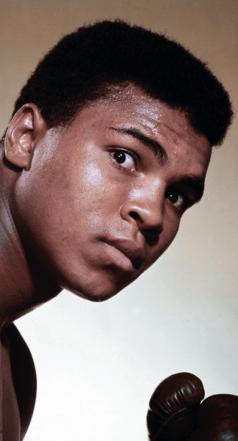
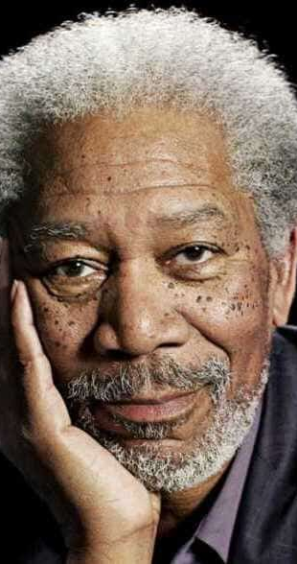
“If my mind can conceive it, if my heart can believe it – then I can achieve it.” (Muhammad Ali)
INSPIRATION
“How do we change the world?
One random act of kindness at a time”
(Morgan Freeman)

Slide 3

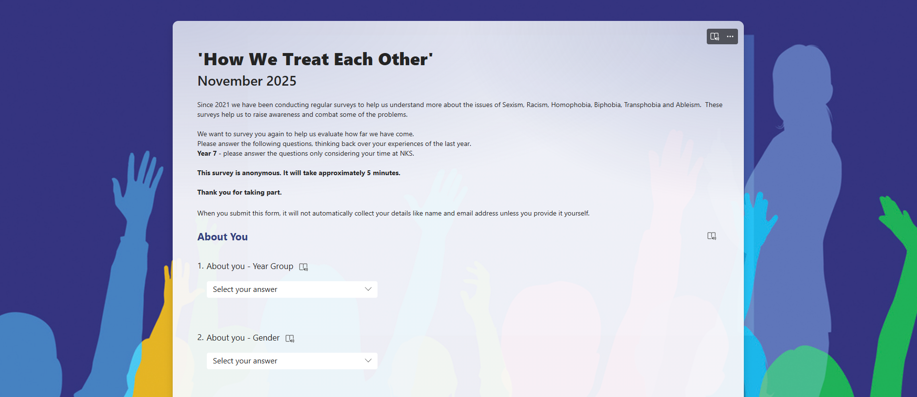
‘How We Treat Each Other’ - survey 2025
Since 2021 we have regularly asked students to complete a survey to help us understand more about the issues of Sexism, Racism, Homophobia, Biphobia, Transphobia and Ableism.
These surveys help us to raise awareness and combat some of the problems.
A link to the 2025 survey will be sent to all students via satchel:one on Monday 10th November.
Please take a few minutes to complete it.

Slide 4

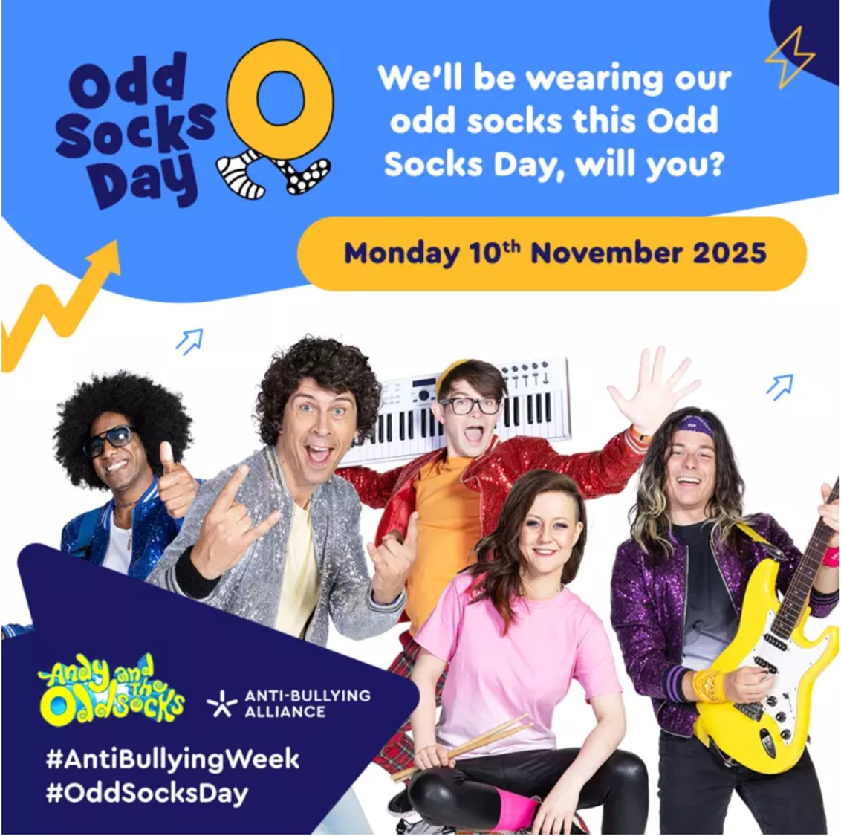
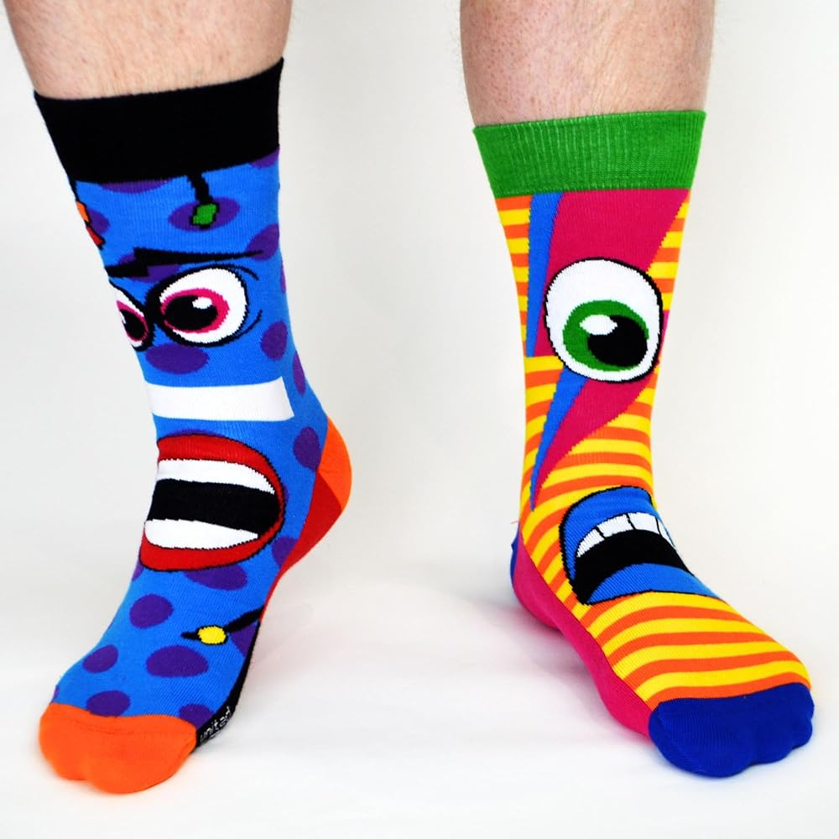
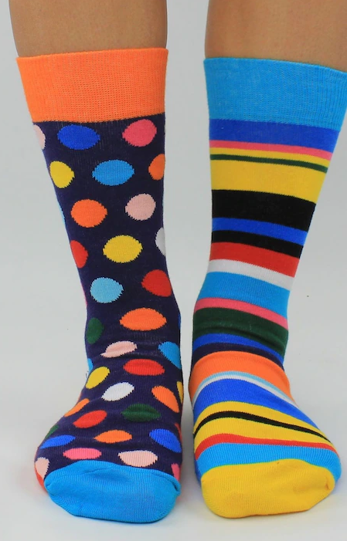

Slide 5
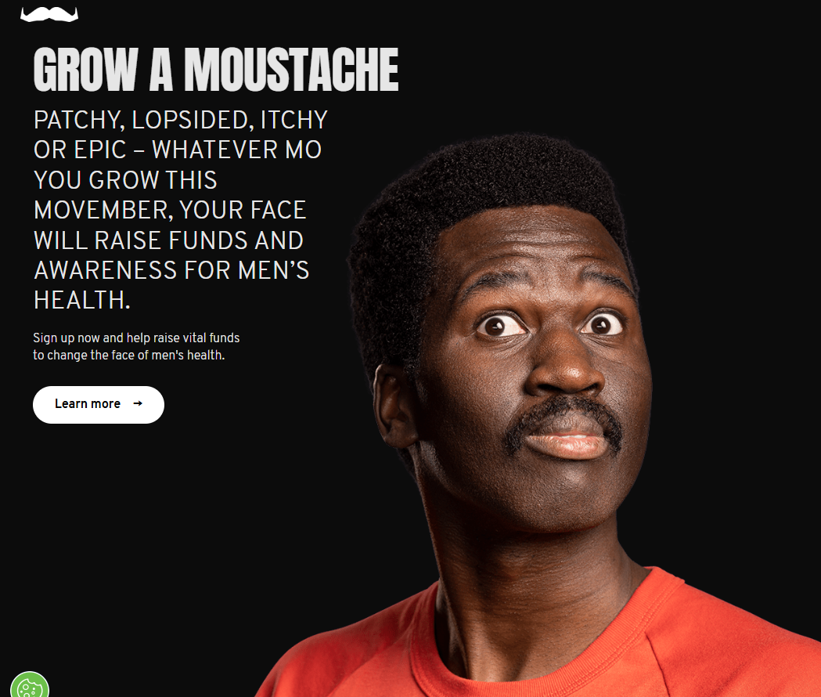


Visit the MOVEMBER website for more details: uk.movember.com
Check back next month for a gallery of Mos.

Slide 6


Slide 7



Slide 8


Slide 9
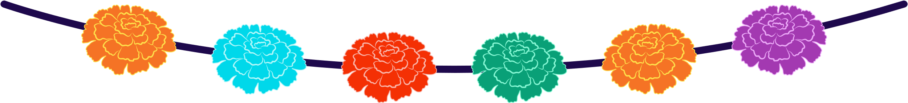

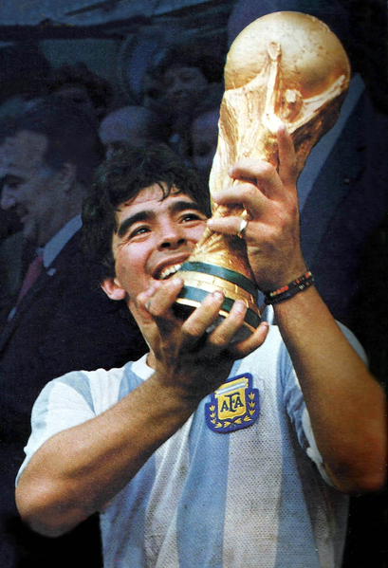
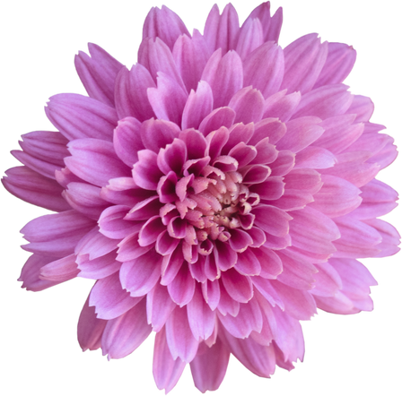
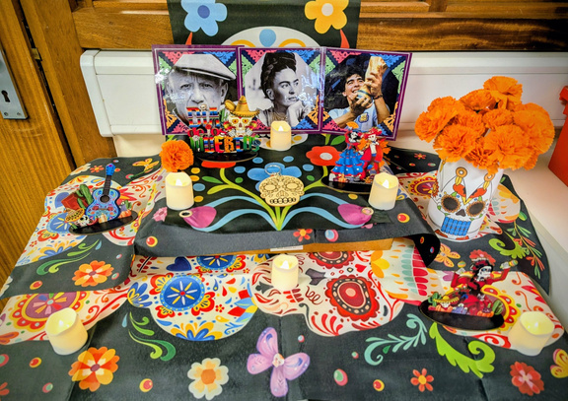
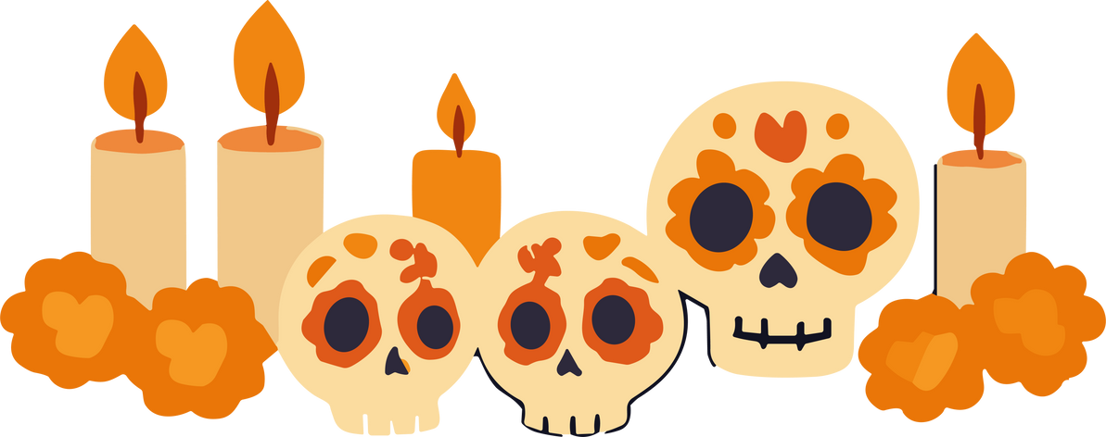
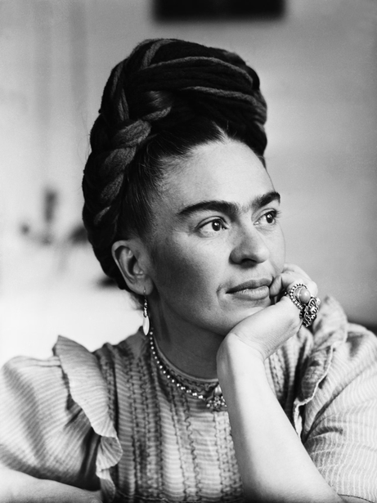
CULTURAL
Awareness!
A JOURNEY THROUGH TWO TRADITIONS OF REMEMBRANCE
Every year, around the beginning of November, many countries pause to remember loved ones who have passed away. In Spanish-speaking countries such as Mexico, people celebrate El Día de los Muertos (the Day of the Dead) on 1st and 2nd November. Meanwhile, in France and Belgium, people observe La Toussaint (All Saints’ Day) on 1st November. Although these two traditions are very different in atmosphere, both share the same purpose: honouring and remembering those who are no longer with us.
Día de los Muertos – A Celebration of Life
La Toussaint – A Day of Reflection
🎨 Culture Club
Far from being a sad occasion, El Día de los Muertos is a colourful and joyful celebration.
Families create altars (ofrendas) at home to welcome back the spirits of their loved ones. These altars are decorated with:
Photos of the deceased
Candles, flowers (especially marigolds, cempasúchil)
Food and drinks they enjoyed
Sugar skulls (calaveras) and papel picado (paper decorations)
Music, parades, and face-painting also form part of the celebration, symbolising that death is not an end but a continuation of life in memory and spirit.
In France and Belgium, La Toussaint is a public holiday celebrated on 1st November.
Families visit cemeteries to clean and decorate graves with chrysanthemums, the traditional flower of remembrance.
It’s a quieter, more reflective occasion, marked by respect and contemplation rather than festivity.
Despite their differences, both traditions teach an important lesson:
Remembering those we’ve lost keeps them alive in our hearts.
In Culture Club, we created our very own altar, inspired by El Día de los Muertos.
Our altar included photos of Pablo Picasso, Frida Kahlo, and Diego Maradona — all famous for having left an unforgettable mark on art, culture, and sport.
This activity helped us reflect on how language, culture, and memory connect us across borders.
Challenge 1
Challenge 2
Design a new symbol that brings together:
the poppy (Remembrance Day),
the marigold (Día de los Muertos),
and/or the chrysanthemum (La Toussaint).
It could be:
a drawing or digital design,
a 3D model (paper, fabric, clay, etc.),
or a photo collage.
Write a short reflection or poem (6–10 lines) on the theme of memory, peace, or someone who inspires you.
Example prompts:
“If I could thank one person from the past…”
“How my culture remembers…”
“What poppies, marigolds, and chrysanthemums mean to me…”
📩 Submission Info
📍 Email or give your work to Mrs Aslan-Isted in B35.
👥 Individual or group entries (max 3 per group).
🏅 Winning works will be displayed on NKS Facebook page and students will get a Level 2 Achievement point.

Slide 10
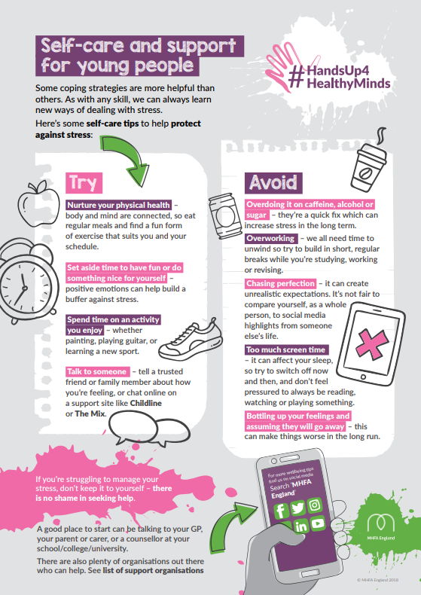
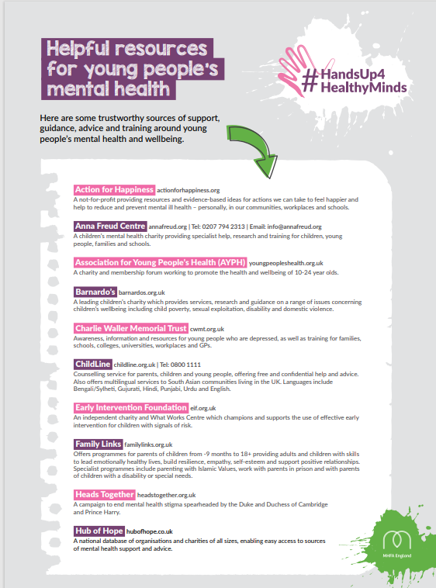

Slide 11
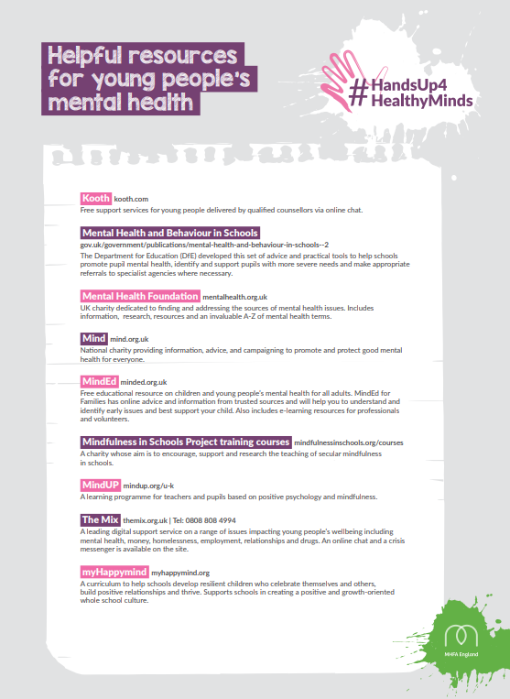
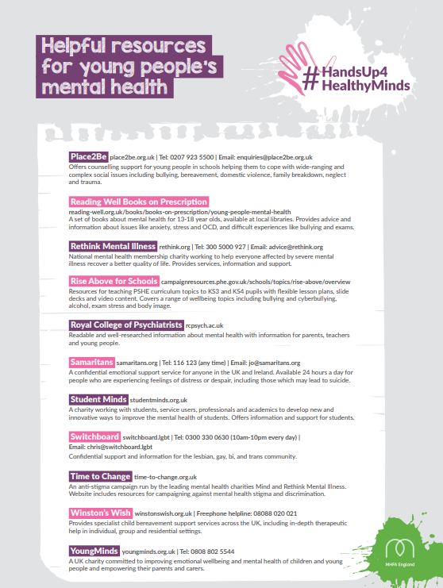

Slide 12

Kooth - is a free, safe, and anonymous online platform where young people can access mental health support whenever they need it (Video 1:30 mins – click to play)

