Slide 1

The NKS Healthy Community Blog
NKS is a school for people like me
The purpose of this monthly blog is to promote a healthy culture and ethos across the school - a culture that challenges inequality and promotes positive ideals of how we should respect and treat each other.
Volume 3 – Jan ‘26

Slide 2
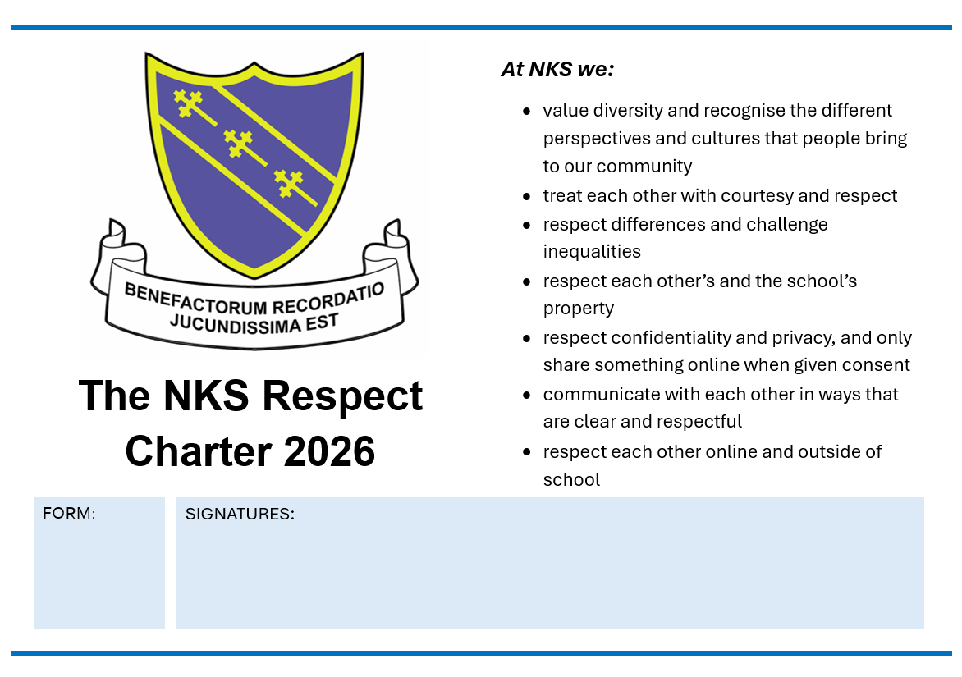
The NKS Respect Charter was created by the School Council a few years ago.
Our current School Council reviewed and agreed it again, just before Christmas.
It is a public way of expressing how we expect to be treated and therefore how we should treat others.
The idea is that each form group discusses the Charter and that everybody in the form signs to agree to uphold it.
The poster is then displayed in the form room to publicly pledge that this is what we believe in.
Posters will be given to Form Tutors in the second week of January 2026.

Slide 3


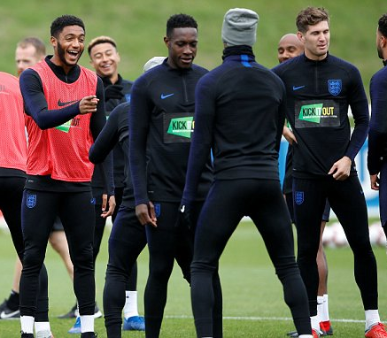

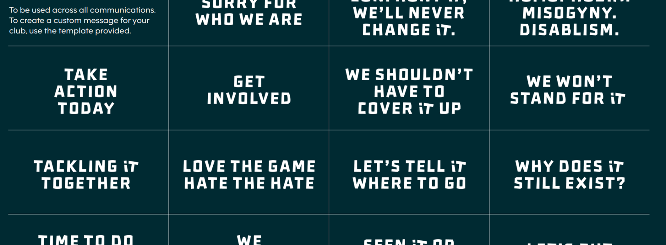

Slide 4

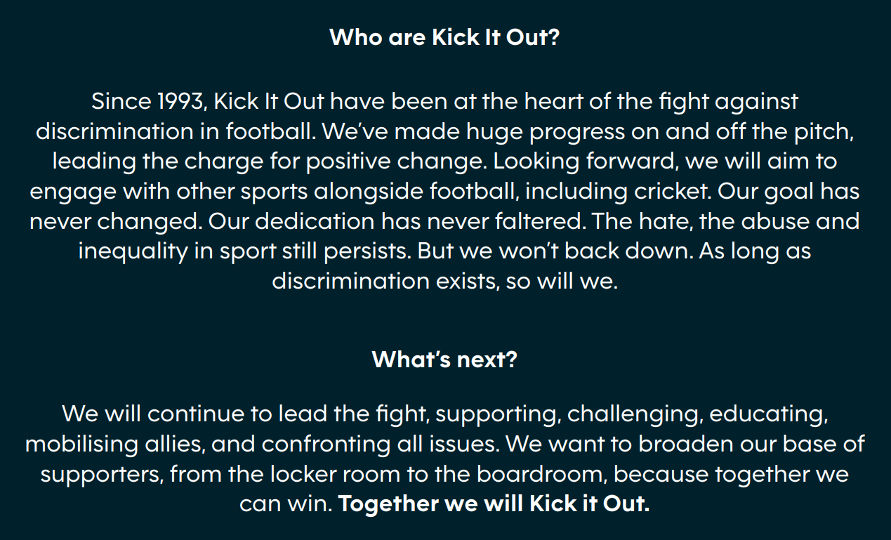



Slide 5


Slide 6


https://enough.campaign.gov.uk/

Slide 7
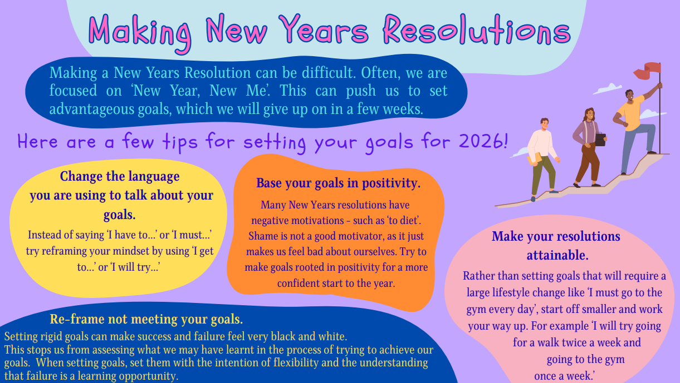

Slide 8
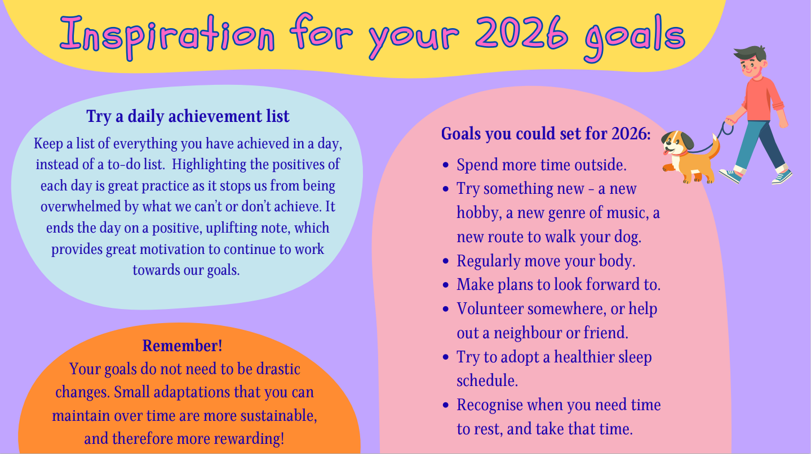

Slide 9
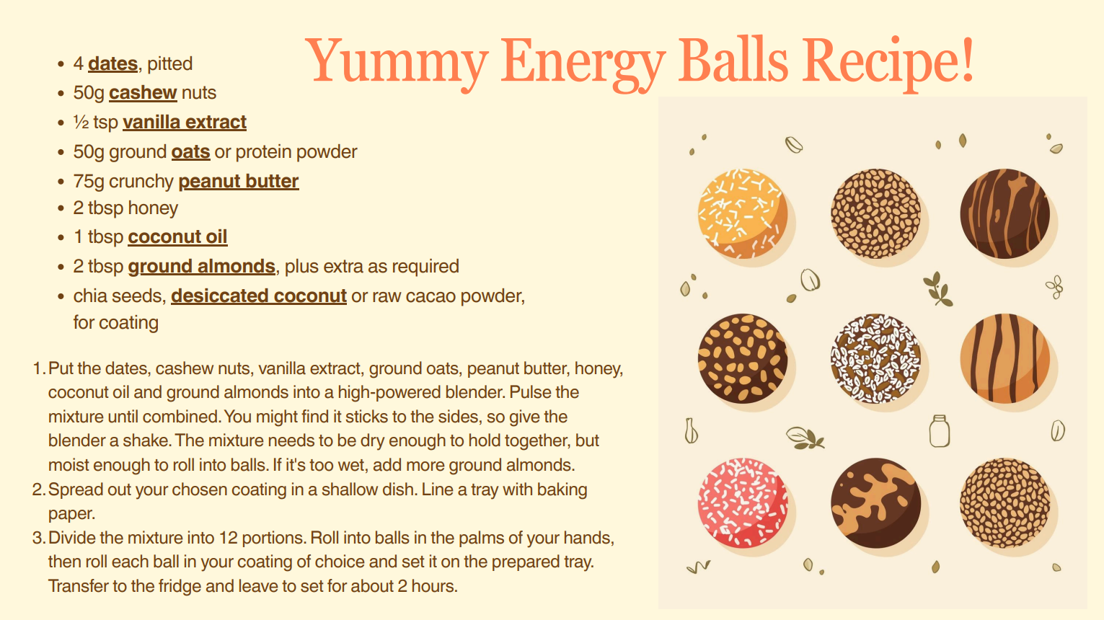

Slide 10
HEALTHY COMMUNITY WORD SEARCH - FIND THE MISSING WORD
Amazing
Caring
Considerate
Friendship
Fun
Help
Kindness
Loyal
Respect
Sharing
Support
Thoughtfulness
Understanding
T | M | R | I | J | G | K | H | C | S | J | O | G | G | I
L | H | W | O | M | S | A | I | O | X | T | N | V | N | J
Y | Z | O | Q | T | W | Y | V | N | G | I | A | S | I | C
U | V | N | U | B | F | R | T | S | D | L | C | C | Z | T
A | D | F | A | G | I | Z | O | N | H | N | U | W | A | C
S | Y | J | U | E | H | B | A | I | M | F | E | A | M | E
H | A | V | A | N | O | T | S | Y | V | A | O | S | A | P
A | I | S | E | V | S | C | F | E | F | U | G | F | S | S
R | F | C | A | R | I | N | G | U | A | P | T | A | T | E
I | B | L | E | O | D | W | O | Z | L | I | U | V | B | R
N | K | D | P | G | K | A | R | E | O | N | D | C | Y | I
G | N | G | R | H | P | I | H | S | D | N | E | S | W | C
U | C | O | N | S | I | D | E | R | A | T | E | S | W | C
I | P | C | A | E | W | O | F | L | A | Y | O | L | S | I
Send your answer to : krowell@nks.kent.sch.uk by the 16th January 2026. For all correct answers received, 2 achievement points will be awarded.

